Slide 1
KONFIDENT-S Interim Analysis: Sebetralstat for HAE Attacks (Including Laryngeal)
Henriette Farkas,¹ Marc A. Riedl,² Emel Aygören-Pürsün,³ William R. Lumry,⁴ Andrea Zanichelli,^{5,6} James Hao,⁷ Matthew Iverson,⁷ Michael D. Smith,⁷ Christopher M. Yea,⁸ Paul K. Audhya,⁷ Jonathan A. Bernstein,^{9,10} Marcus Maurer,^{11,12} Danny M. Cohn¹³
¹Hungarian Angioedema Center of Reference and Excellence, Semmelweis University, Budapest, Hungary; ²University of California – San Diego, La Jolla, CA, USA; ³University Hospital Frankfurt, Frankfurt, Germany; ⁴AARA Research Center, Dallas, TX, USA; ⁵IRCCS Policlinico San Donato, San Donato Milanese, Milan, Italy; ⁶University of Milan, Milan, Italy; ⁷KalVista Pharmaceuticals, Cambridge, MA, USA; ⁸KalVista Pharmaceuticals, Salisbury, United Kingdom; ⁹University of Cincinnati College of Medicine, Cincinnati, OH, USA; ¹⁰Bernstein Clinical Research Center, Cincinnati, OH, USA; ¹¹Institute of Allergology, Charité–Universitätsmedizin Berlin, Berlin, Germany; ¹²Fraunhofer Institute for Translational Medicine and Pharmacology ITMP, Immunology and Allergology, Berlin, Germany; ¹³Amsterdam UMC, University of Amsterdam, Amsterdam, Netherlands

Slide 2
Disclosures
Henriette Farkas has received research grant support from CSL Behring, Pharming, and Takeda, and has served as an advisor for these companies and for Astria Therapeutics, BioCryst Pharmaceuticals, Intellia Therapeutics, Ionis Pharmaceuticals, KalVista Pharmaceuticals, Ono Pharmaceutical, and Pharvaris.
This study was funded by KalVista Pharmaceuticals

Slide 3
Background
Given that attacks are unpredictable and have the potential to rapidly progress, treatment guidelines recommend that patients
Treat attacks as early as possible to halt the progression and shorten attack duration^{1,2}
Carry sufficient on-demand therapy to treat 2 attacks at all times^{1,2}
Consider treating all attacks, irrespective of attack location or severity^{1,2}
In the randomised, double-blind, placebo-controlled, phase 3 KONFIDENT crossover trial, oral on-demand sebetralstat provided faster symptom relief, reduction in attack severity, and complete attack resolution compared with placebo³
The objectives of the KONFIDENT-S trial are to assess the safety and effectiveness of long-term use of sebetralstat as an on-demand treatment of HAE attacks in adolescents and adults with HAE-C1INH

Slide 4
KONFIDENT-S Open-Label Extension Trial Design
Rollover participantsª
End-of-study visit
Inclusion criteria (up to 150 participants):
≥12 years of age
≥2 documented HAE attacks within 3 months
Enrollment visit^{c}
Treatment period (0-24 months)
De novo participants^{b}
Treatment:
Participants were instructed to self-administer sebetralstat 600 mg (2 x 300-mg tablets) as early as possible after attack onset
A second administration was allowed if warranted
Monthly visits
Quarterly
visits
In-clinic
All other months
Televisit
Endpoints:
Safety (adverse events)
Time to beginning of symptom relief (by PGI-C)^{d}
Time to first reduction in severity (by PGI-S)^{d}
Time to complete attack resolution (by PGI-S)^{e}
Months
0
3
4
21
23
24
Multiple real-world elements were incorporated into the trial design, including televisits, portable multidose packs, and the elimination of a need to contact a call center or investigator before, during, or after attacks.

Slide 5
Participant Demographics and Disease-specific History
Age group
 | All participants N=84 | Participants experiencing laryngeal attacks n=7
Age, median (IQR), years | 35.0 (22.0 to 47.0) | 31.0 (25.0 to 56.0)
Sex, female, n (%) | 54 (64.3) | 5 (71.4)
Race, n (%)
White | 63 (75.0) | 7 (100.0)
Asian | 12 (14.3) | 0
Other | 2 (2.4) | 0
Not reported | 7 (8.3) | 0
BMI, median (IQR), kg/m² | 25.6 (22.3 to 31.1) | 29.3 (19.9 to 31.0)
HAE-C1INH type, n (%)
Type 1 | 77 (91.7) | 7 (100.0)
Type 2 | 7 (8.3) | 0
Adults (≥18 years old)
Adolescents (12-17 years old)ª
Current treatment regimen
On-demand + LTP^{b,c}
On-demand only

Slide 6
Attack Characteristics
Primary pooled attack locations^{c}
 | Sebetralstat-treated attacks N=640
Primary attack locations,^{a,b} n (%)
Abdomen | 244 (38.1)
Arms/hands | 190 (29.7)
Legs/feet | 154 (24.1)
Head/face/neck | 56 (8.8)
Torso | 43 (6.7)
Genitals | 37 (5.8)
Larynx/throat | 14 (2.2)
Mucosal (abdomen/larynx)
Subcutaneous (all others)
Baseline PGI-S category^{d}
Participants treated a median of 5 attacks with sebetralstat (IQR, 2 to 8; range, 1 to 37)
20 participants treated ≥9 attacks
All
attacks
Laryngeal
attacks
Severe/Very severe
Moderate
Mild

Slide 7
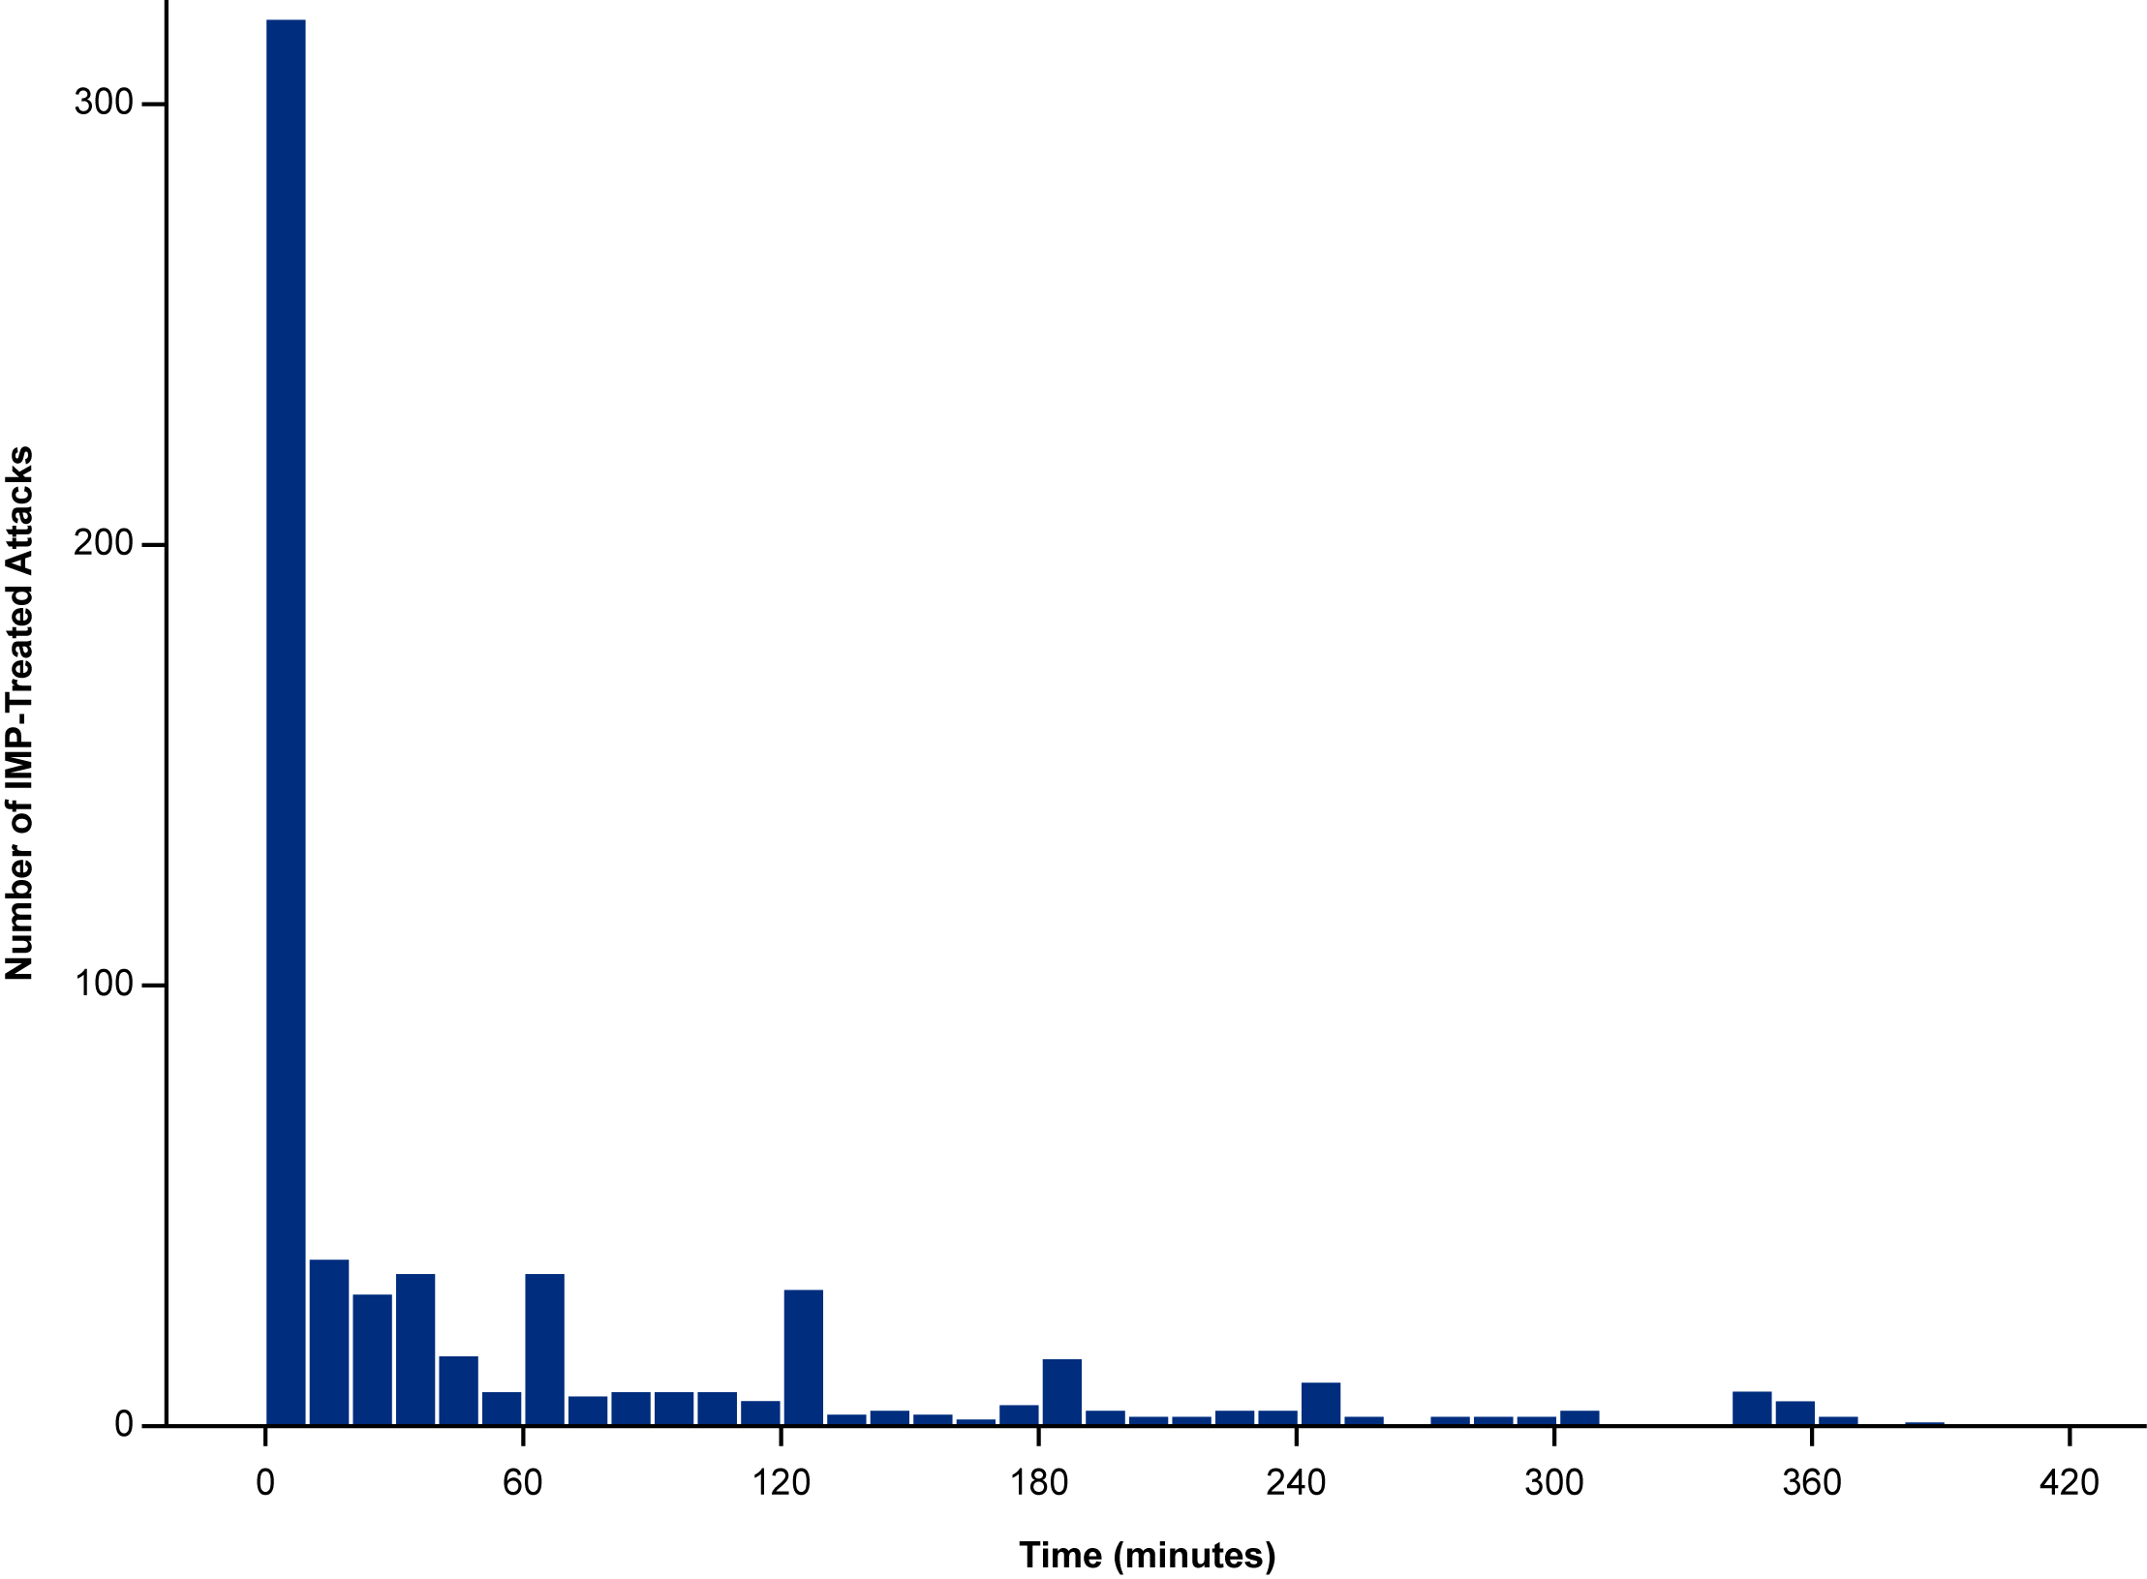
Time from Attack Recognition to Sebetralstat Administration
The median time from attack recognition to treatment was 9 minutes (IQR, 1 to 69)
14 laryngeal attacks (2.2%) were treated with sebetralstat
Median time from onset of attack to first administration of 8 minutes (IQR, 1 to 27)
In KONFIDENT, the median time from attack recognition to treatment was 41 minutes (IQR, 6 to 140)¹
Number of sebetralstat-treated attacks
Time (minutes)

Slide 8
Interim Safety Results (640 Attacks Treated with Sebetralstat)
 | All participants N=84
Any TEAE | 47 (56.0)
Treatment-related | 8 (9.5)
Serious TEAE | 3 (3.6)
Treatment-related | 0
Severe TEAE | 5 (6.0)
Treatment-related | 1 (1.2)
Any TEAE leading to permanent discontinuation | 4 (4.8)
Treatment-related | 2 (2.4)
Any TEAE leading to death | 0
Severe treatment-related TEAE: one incident of grade 3 diarrhea that started 1 day prior to sebetralstat administration was assessed as unrelated by the investigator after the data cutoff (attack location: arms/ hands/legs/feet)
Treatment-related TEAE leading to permanent discontinuation: one incident of grade 2 skin burning sensation (arms/hands) and 1 incident of grade 2 nausea (abdominal)
The safety profile of sebetralstat was consistent with that observed in the KONFIDENT trial
Notes:
ªSerious TEAE was defined as any untoward medical occurrence that at any dose resulted in death, was life-threatening, required inpatient hospitalization or prolongation of existing hospitalization, resulted in persistent or significant disability/incapacity, was a congenital anomaly/birth defect, or was an important medical event by medical and scientific judgment. ^{b}Severe (grade 3 or 4) TEAEs were evaluated by investigators according to the Toxicity Grading Scale for Healthy Adult and Adolescent Volunteers Enrolled in Preventive Vaccine Clinical Trials. Note: Data cutoff date of 31 January 2024.

Slide 9
Interim Efficacy Results
 | KONFIDENT-S All treated attacks N=640 | KONFIDENT-S Laryngeal attacks n=14 | KONFIDENT¹ Attacks treated with 600 mg n=93
Time to beginning of symptom relief within 12 hours, hours
Median (IQR) | 1.80 (0.95 to 5.45) | 1.3 (0.5 to 5.3) | 1.79 (1.02 to 3.79)
Time to reduction in attack severity within 12 hours, hours
Median (IQR) | 6.57 (1.61 to >12) | 1.5 (0.8 to 6.1) | 7.75 (2.19 to >12)
Time to complete resolution within 24 hours, hours
Median (IQR) | 21.02 (7.22 to >24) | 6.8 (1.8 to >24) | 24.00 (7.54 to >24)
Through 24 hours, 486 attacks (75.9%) were treated with one dose of sebetralstat
149 attacks (23.3%) were treated with two doses of sebetralstat
Conventional on-demand treatments were used for 36 attacks (5.6%) within 12 hours of the first dose of sebetralstat
Conventional on-demand treatment were used within 12 hours after first taking sebetralstat 600 mg for 8 attacks (8.6%) in KONFIDENT¹

Slide 10
Key Takeaways
Data from this OLE trial show that oral sebetralstat enabled participants to treat attacks early, consistent with global HAE treatment guidelines
Median time to treatment was shorter in the KONFIDENT-S OLE trial (9 minutes [IQR, 1 to 69]) than in the phase 3 KONFIDENT trial (41 minutes [IQR, 6 to 140]),¹ potentially reflecting the real-world nature of KONFIDENT-S
In this OLE trial, safety and efficacy results with sebetralstat were consistent with those observed in the randomised phase 3 KONFIDENT trial¹
Results in attacks involving the larynx were consistent with those observed across all attacks in both KONFIDENT¹ and KONFIDENT-S
KONFIDENT-S OLE trial is ongoing; additional interim analyses are planned. As of 21 August 2024, 129 participants have treated 1516 attacks (32 laryngeal) with sebetralstat.

