Slide 1
Agreement of Patient Global Impression of Change With Attack Resolution or Use of Rescue Medication in Patients With Hereditary Angioedema
Paul Audhya,*¹ Peter Williams,² Christopher Yea,¹ Danny Cohn³
¹KalVista Pharmaceuticals, Inc., Salisbury, UK, and Cambridge, MA, US; ²Veramed Limited, Twickenham, UK; ³Department of Vascular Medicine, Amsterdam University Medical Centers, University of Amsterdam, Netherlands
*Presenting author

Slide 2
Background

Slide 3
Background
Hereditary angioedema (HAE) is a rare genetic disease caused by deficiency or dysfunction of C1-inhibitor, a key regulator of the kallikrein-kinin system^{1,2}
Lack of C1-inhibitor leads to uncontrolled activity of plasma kallikrein, which triggers excessive release of bradykinin; this in turn can lead to episodic HAE attacks³
KVD900 is an investigational oral plasma kallikrein inhibitor in development for the on-demand treatment of HAE attacks
The efficacy and safety of KVD900 was evaluated in a phase 2, randomized, double-blind, placebo-controlled crossover trial in patients with HAE
1. Bork K, et al. Am J Med. 2006;119(3):267-274. 2. Levi M, Cohn DM. Transfus Med Rev. 2019;33(4):243-247. 3. Busse PJ, et al. J Allergy Clin Immunol Pract. 2021;9(1):132-150.e3.

Slide 4
Background (continued)
This trial met the primary efficacy endpoint, demonstrating significantly longer time to use of rescue medication with KVD900 vs placebo
Improvements were also observed in patient-reported outcomes (PROs) measured using the Patient Global Impression of Change (PGI-C) scale, Patient Global Impression of Severity (PGI-S) scale, and visual analog scale (VAS)
The PGI-C scale is a common clinical measure of symptom improvement in various disease conditions, and has also been used to evaluate treatment effect in HAE clinical studies^{1,2}
In this post hoc analysis, we evaluated agreement between improvement observed on the PGI-C scale and 3 other efficacy outcome measures (use of rescue medication, symptom resolution per PGI-S scale, and symptom resolution per VAS) in the KVD900 phase 2 trial
1. Perrot S, Lantéri-Minet M. Eur J Pain. 2019;23(6):1117-1128. 2. Craig TJ, et al. J Allergy Clin Immunol. 2009;124(4):801-808.

Slide 5
Methods

Slide 6
Methods Phase 2 Study Population and Design
This phase 2 trial (ClinicalTrials.gov ID: NCT04208412) included adult (aged ≥18 years) patients with HAE type I or II who had experienced at least 3 attacks in the past 93 days and were not on prophylactic therapy
Following an initial open-label pharmacokinetic phase, patients were randomized to treat 2 eligible HAE attacks with KVD900 (600 mg) or placebo in 1 of 2 sequences in a double-blind crossover trial (Figure 1)
Patients experiencing attacks were eligible for treatment if the attacks were mild or moderate in severity and did not involve the face or larynx

Slide 7
Methods (continued) Phase 2 Study Population and Design
Figure 1. Study Design
PK, pharmacokinetic; R, randomized.

Slide 8
Methods (continued) Outcome Measures Included in Post Hoc Analysis
Improvement per PGI-C scale was assessed in 2 ways: 1) achievement of “A Little Better” or higher for 2 consecutive time points and 2) achievement of “Better” or higher for 1 time point (Figure 2)
Use of rescue medication was defined as use of conventional on-demand treatment for the attack within the assessment period
Attack resolution per PGI-S scale was defined as a PGI-S rating of “None”
Attack resolution per VAS was defined as all 3 VAS component scores being <10 for 3 consecutive time points
Attacks with all 3 VAS components being <10 at baseline were excluded from the analysis of attack resolution according to VAS

Slide 9
Methods (continued) Outcome Measures Included in Post Hoc Analysis
Figure 2. Outcome Measures
The PGI-C assessed symptom improvement on a 7-point scale from “Much Better” to “Much Worse.” The PGI-S assessed HAE attack severity on a 5-point scale from “None” to “Very Severe.” The VAS measured severity of HAE attack symptoms on a 100-mm scale ranging from 0 (none) to 100 (maximum severity).
HAE, hereditary angioedema.

Slide 10
Methods Statistical Analysis
Cross-tabulation analysis was used to evaluate agreement between improvements achieved on the PGI-C scale and 3 other outcome measures: rescue medication use, attack resolution according to PGI-S, and attack resolution according to VAS over a 24-hour period after study drug administration
The sensitivity and specificity of the PGI-C endpoint compared with each comparator was assessed using standard sensitivity and specificity calculations
Cohen’s kappa was calculated to assess the agreement (consistency) between the outcomes

Slide 11
Results

Slide 12
Results
60 patients completed treatment for at least 1 HAE attack (n=113 attacks)
A PGI-C score of “A Little Better” or higher for 2 consecutive time points was achieved in 71.7% (81/113) of attacks within the 24-hour assessment period
Attacks that achieved a PGI-C score of “A Little Better” or higher for 2 consecutive time points were less likely to result in use of rescue medication and more likely to achieve attack resolution by PGI-S and VAS compared with attacks that did not achieve PGI-C “A Little Better” or higher for 2 consecutive time points (Figure 3)
A PGI-C score of “Better” or higher was achieved in 58.4% (66/113) of attacks within the 24-hour assessment period
Attacks that achieved a PGI-C score of “Better” or higher for 1 time point were less likely to result in use of rescue medication and more likely to achieve attack resolution by PGI-S and VAS compared with attacks that did not achieve PGI-C “Better” or higher for 1 time point (Figure 4)

Slide 13
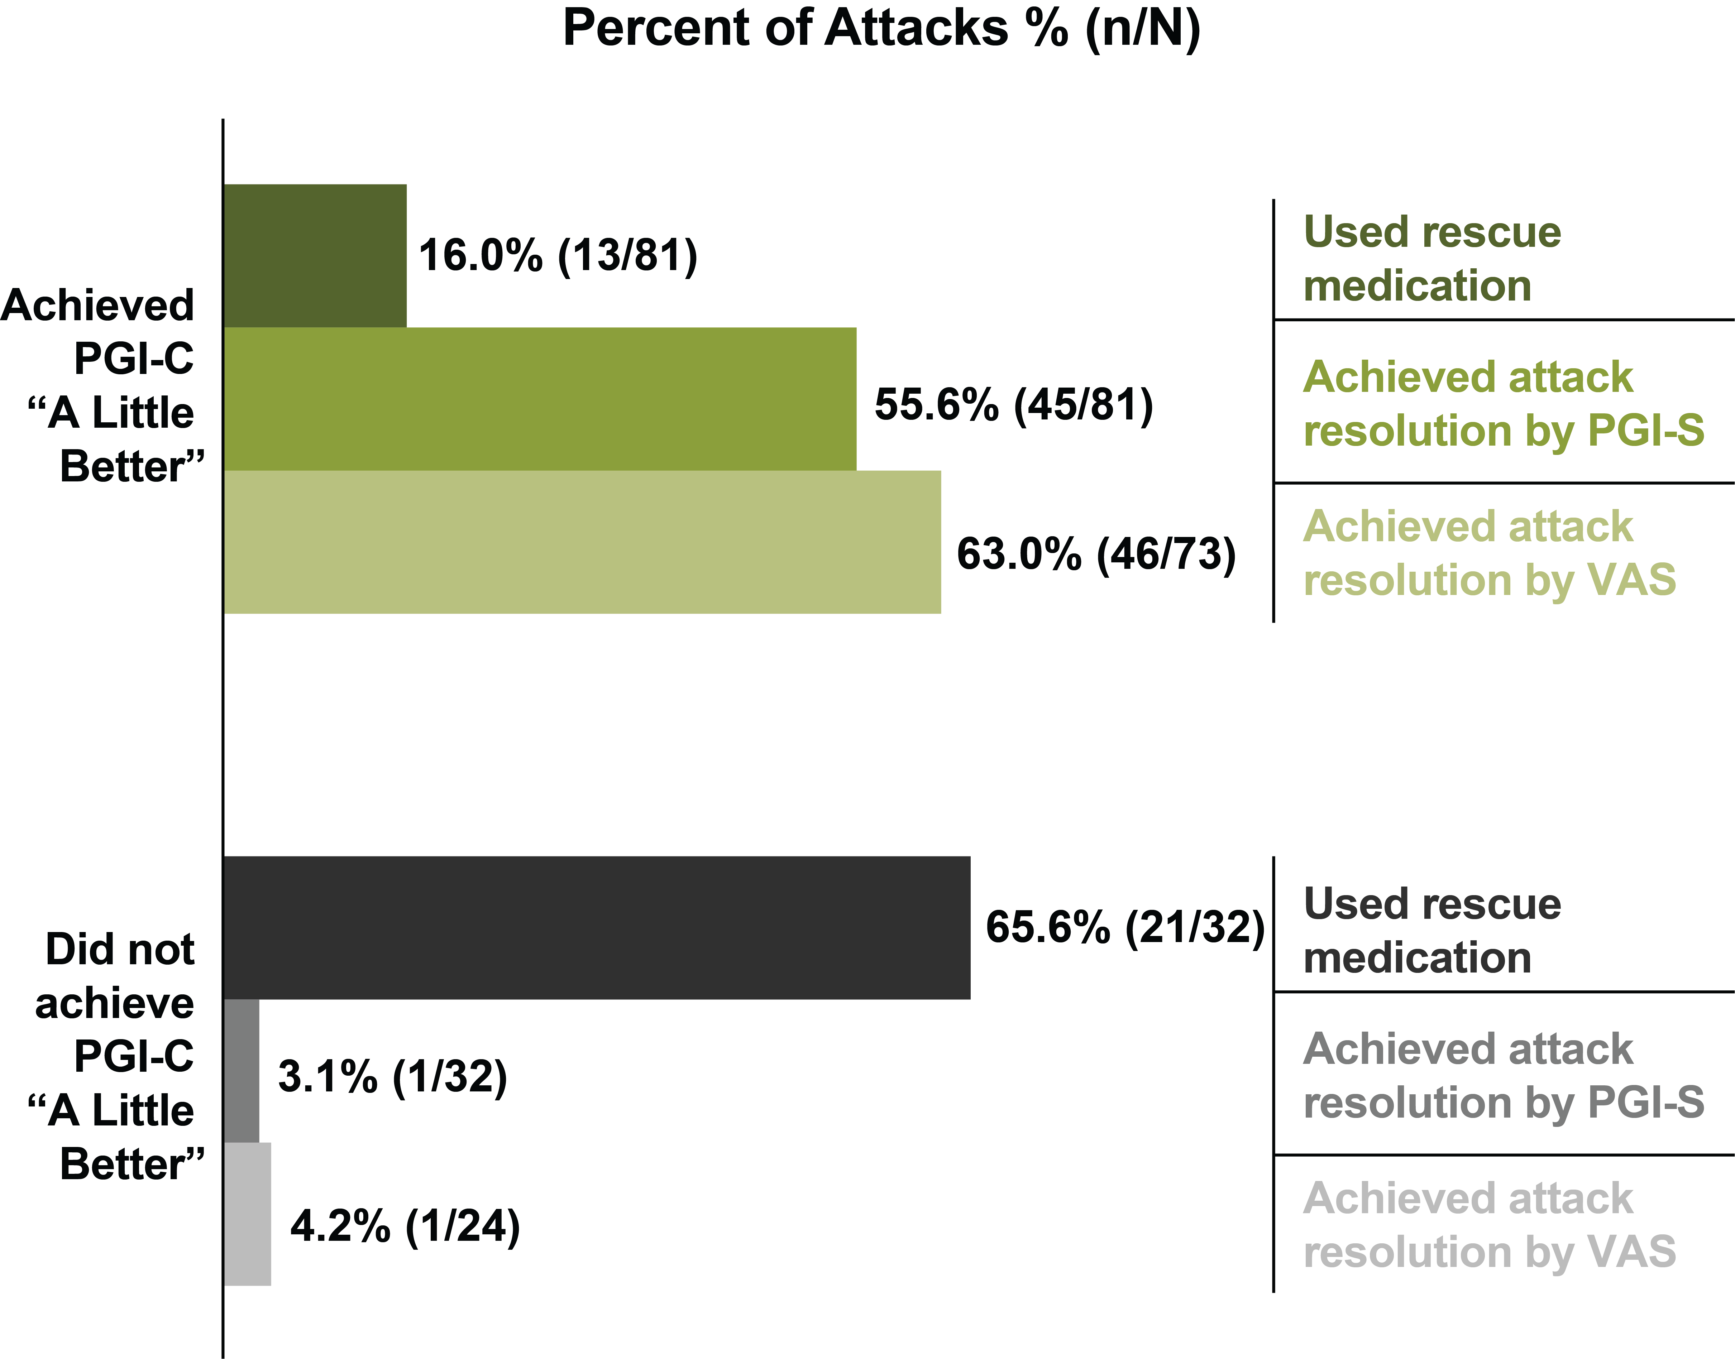
Figure 3. Rescue Medication Use and Attack Resolution in Attacks That Achieved or Did Not Achieve PGI-C “A Little Better” for 2 Consecutive Time Points Within 24 Hours
All time points prior to rescue medication use within the assessment period are considered. Attack resolution according to PGI-S is defined as a PGI-S rating of “None.” Attack resolution according to VAS is defined as all 3 VAS component scores being <10 for 3 consecutive time points. Attacks with all VAS components scoring <10 at baseline were excluded.
PGI-C, Patient Global Impression of Change; PGI-S, Patient Global Impression of Severity; VAS, visual analog scale.

Slide 14
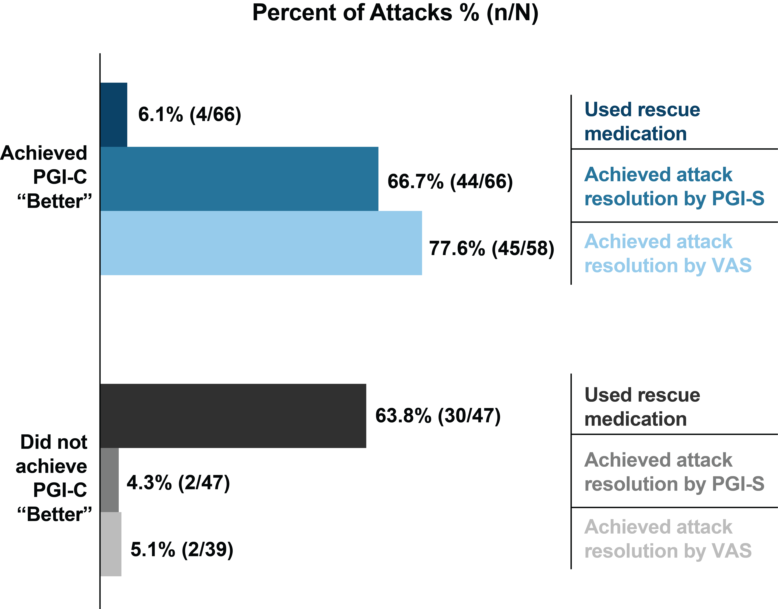
Figure 4. Rescue Medication Use and Attack Resolution in Attacks That Achieved or Did Not Achieve PGI-C “Better” for 1 Time Point Within 24 Hours
All time points prior to rescue medication use within the assessment period are considered. Attack resolution according to PGI-S is defined as a PGI-S rating of “None.” Attack resolution according to VAS is defined as all 3 VAS component scores being <10 for 3 consecutive time points. Attacks with all VAS components scoring <10 at baseline were excluded
PGI-C, Patient Global Impression of Change; PGI-S, Patient Global Impression of Severity; VAS, visual analog scale

Slide 15
Results (continued)
Sensitivity, specificity, and Cohen’s kappa are summarized in Table 1
Cohen’s kappa indicated fair to moderate agreement of PGI-C “A Little Better” for 2 time points with no use of rescue medication, PGI-S, and VAS measures
Cohen’s kappa indicated moderate to substantial agreement of PGI-C “Better” for 1 time point with no use of rescue medication, PGI-S, and VAS measures
A PGI-C score of “A Little Better” for 2 time points was slightly more sensitive at identifying attack resolution and no use of rescue medication within 24 hours than a PGI-C score of “Better” for 1 time point, but was less specific

Slide 16
Table 1. Sensitivity, Specificity, and Cohen’s Kappa for PGI-C Outcome Within 24 Hours From Administration of Study Drug
PGI-C Outcome | Comparator Outcome | Sensitivity | Specificity | Cohen’s Kappa*
“A Little Better” for 2 time points | No use of rescue medication | 0.86 | 0.62 | 0.49
“A Little Better” for 2 time points | Attack resolution by PGI-S | 0.98 | 0.46 | 0.39
“A Little Better” for 2 time points | Attack resolution by VAS | 0.98 | 0.46 | 0.43
“Better” for 1 time point | No use of rescue medication | 0.78 | 0.88 | 0.60
“Better” for 1 time point | Attack resolution by PGI-S | 0.96 | 0.67 | 0.59
“Better” for 1 time point | Attack resolution by VAS | 0.96 | 0.74 | 0.69
*A Cohen’s kappa value of 0.01–0.20 indicates none to slight, 0.21–0.40 as fair, 0.41–0.60 as moderate, 0.61–0.80 as substantial, and 0.81–1.00 as almost perfect agreement between the variables.
PGI-C, Patient Global Impression of Change; PGI-S, Patient Global Impression of Severity; VAS, visual analog scale.

Slide 17
Conclusions

Slide 18
Conclusions
This analysis suggests that achieving improvement on the PGI-C scale was associated with achieving attack resolution and a reduced need for rescue medication in patients with HAE
Patients who reported improvement on the PGI-C scale within 24 hours were less likely to use rescue medication and more likely to achieve attack resolution
Based on a Cohen’s kappa analysis, fair to substantial agreement between PGI-C and other PROs assessing attack resolution and use of rescue medication suggests that improvement on the PGI-C scale was clinically meaningful
A PGI-C score of “A Little Better” for 2 consecutive time points was a slightly more sensitive outcome for identifying attack resolution and no use of rescue medication within 24 hours than a PGI-C score of “Better” for 1 time point, albeit less specific

Slide 19
Acknowledgments
This study was supported by KalVista Pharmaceuticals Ltd. Medical writing assistance was provided under the direction of the authors by Courtney Niland, PhD, of Cadent Medical Communications, LLC, a Syneos Health® group company, and was supported by KalVista Pharmaceuticals, Inc.
Presented during the American Academy of Allergy, Asthma & Immunology Annual Meeting, February 25–28, 2022, Phoenix, AZ.
Disclosures
Paul Audhya and Christopher Yea are employees of KalVista Pharmaceuticals. Peter Williams is an employee of Veramed Limited, and acts as a consultant statistician for KalVista. Danny Cohn has received speaker fees and/or consultancy fees from BioCryst, CSL Behring, Ionis Pharmaceuticals, KalVista Pharmaceuticals, Pharming, Pharvaris, and Shire/Takeda.

